Slide 1



OFFICIAL DOH
BRANDING GUIDELINES
MARCH 9, 2026 – DOH WV CHD
Notes:
Good morning everyone!
A lot of you might have seen our latest posts, be in BAC Procurement, Hiring, etc., that we have changed the color palette of our social media cards. This is in line of the new official DOH Branding, from Calendar Year 2025-2028.
Moreover, please be reminded that this branding was introduced by the COMS Office to CHDs, two weeks ago.

Slide 2



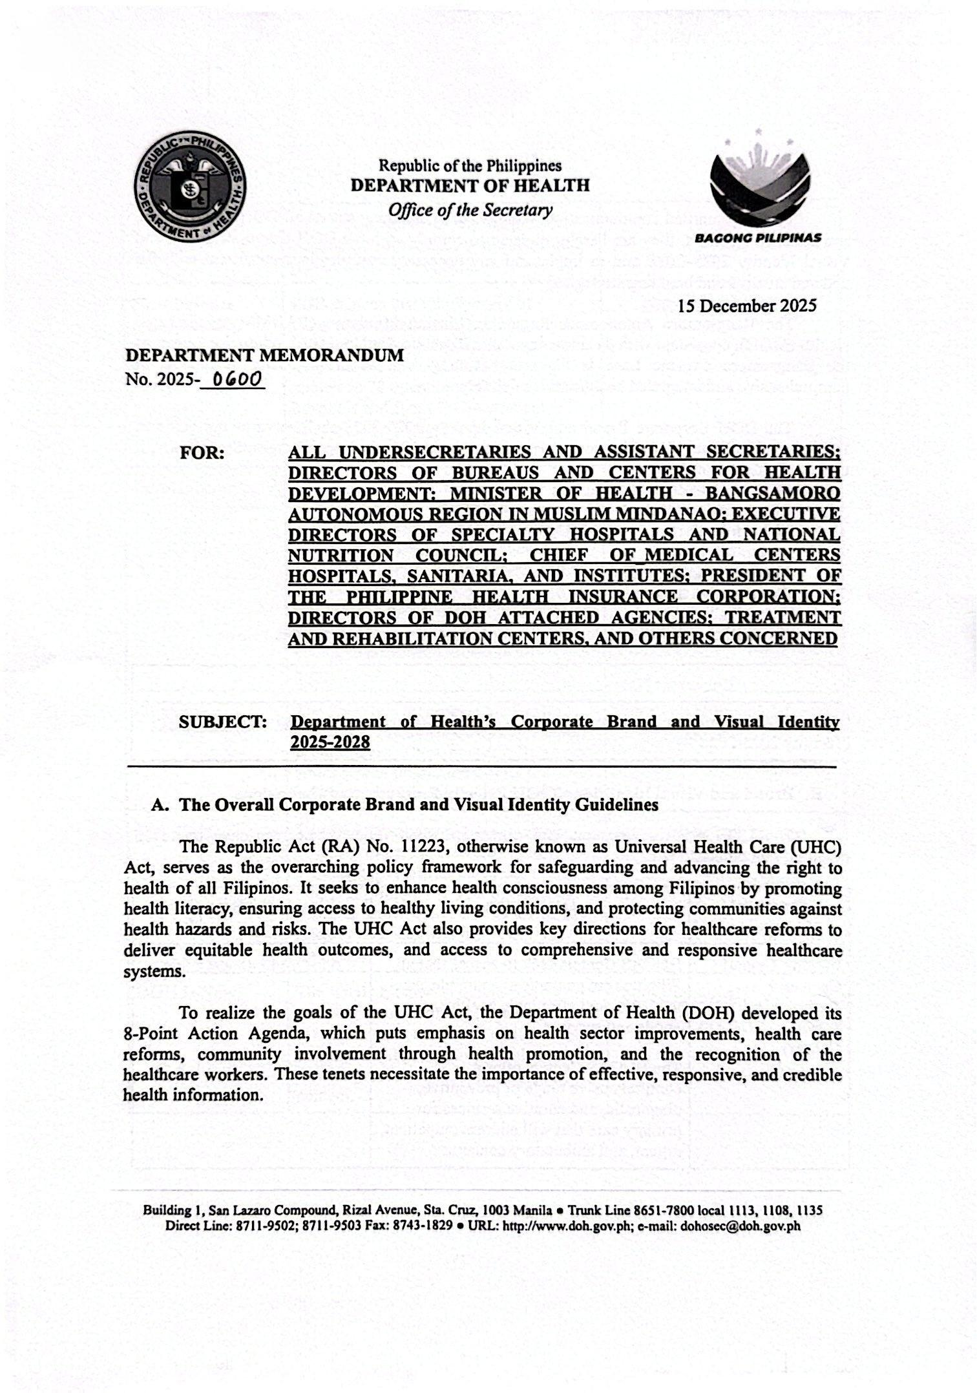
DEPARTMENT MEMORANDUM
No. 2025-0600
Department of Health’s Corporate Brand and Visual Identity 2025-2028
Notes:
As mandated by DM 2025-0600, this is the Department of Health's Corporate Brand and Visual Identity.

Slide 3


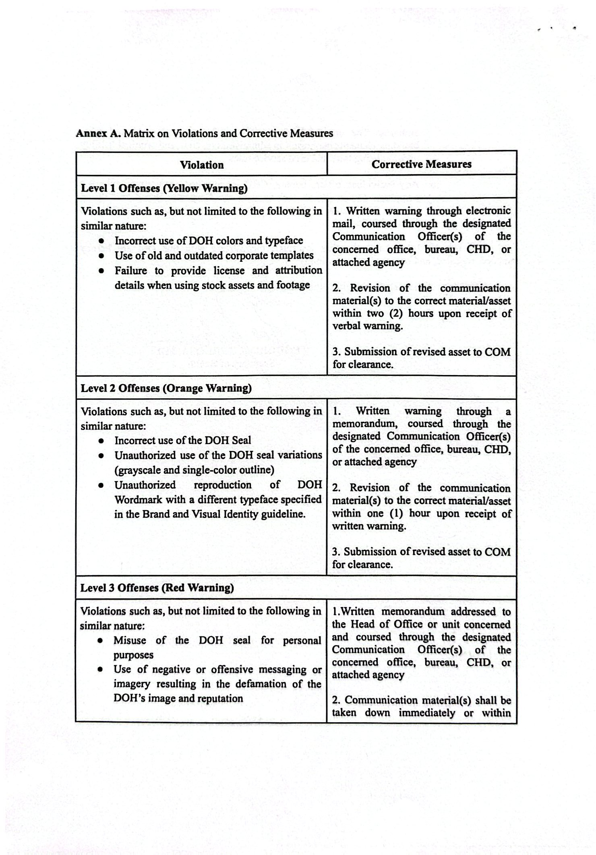
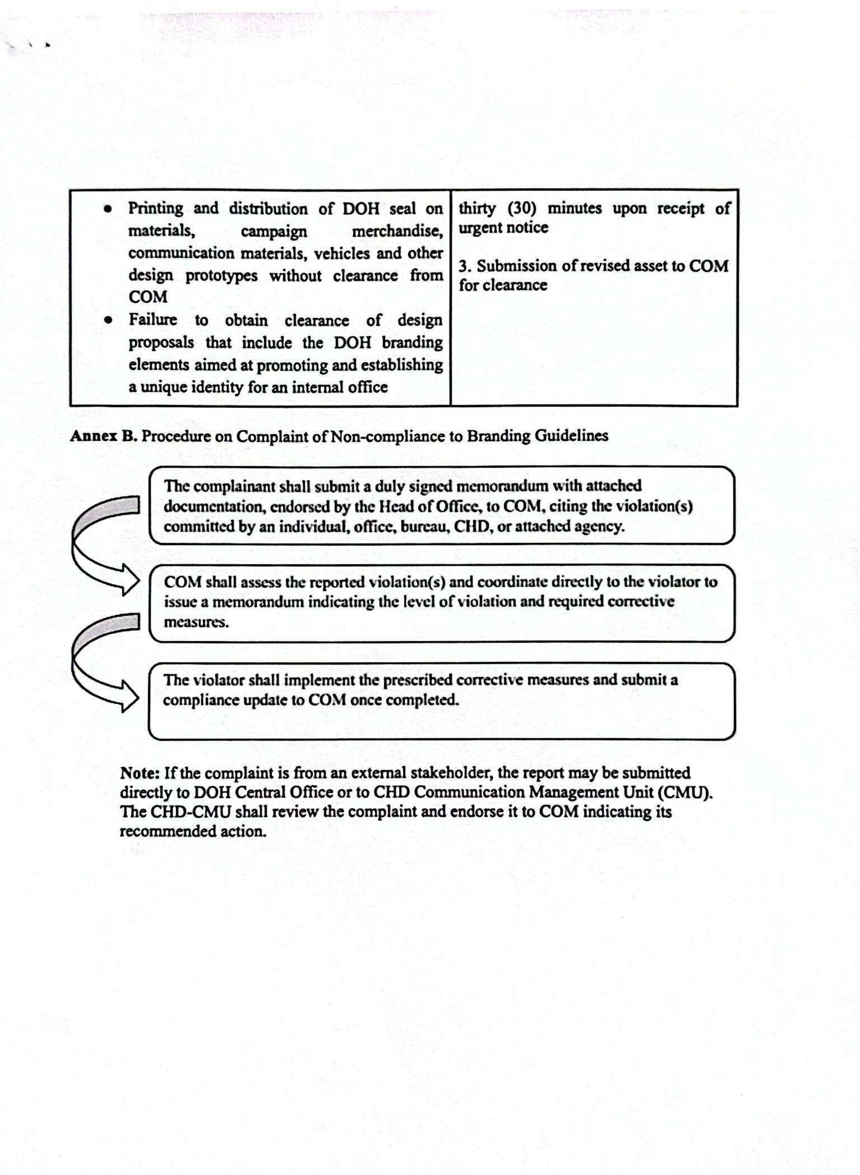
Non – Compliance to Branding Guidelines
Notes:
Moreover, Central Office will be very strict in the implementation of this branding, thus this matrix of violation and corrective measures.

Slide 4
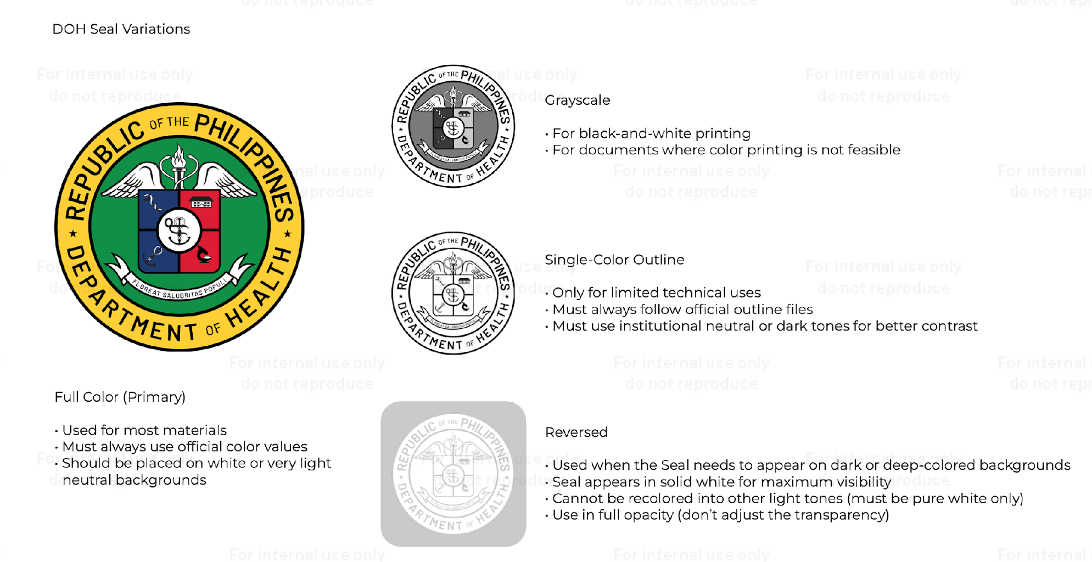

Slide 5
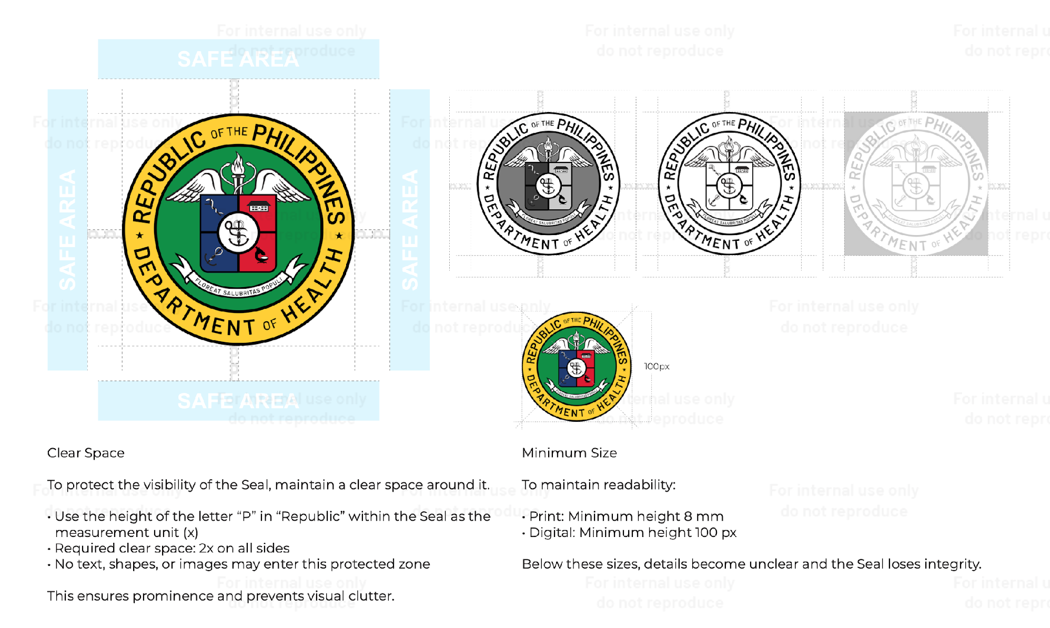
Notes:
Clear Space (Safe Area)
The blue shaded areas labeled SAFE AREA represent the minimum empty space that must surround the DOH seal.
How the measurement works
The guide uses the height of the letter “P” in the word “Republic” within the seal.
This height is labeled “x”.
Required spacing
The seal must have at least 2x clear space on all sides.
Example:
If the height of the letter P = 5 mm
The required space around the seal must be 10 mm on each side.
Why this matters
The clear space ensures:
The seal remains prominent
It does not compete with other logos, text, or graphics
It maintains official integrity and readability
🚫 Inside the safe area, you cannot place:
Text
Other logos
Shapes
Images
Borders
2️⃣ Seal Variations (Color and Monochrome)
The right side shows approved versions of the DOH seal.
Full Color Version
Used for:
Official publications
Posters
Social media graphics
Government reports
Black / Monochrome Version
Used when:
Printing in black and white
Engraving
Documents without color printing
Grayscale Version
Used for:
Photocopies
Low-color print environments
⚠️ The faded example indicates incorrect or discouraged use, such as:
Reduced opacity
Distorted appearance
Poor contrast
3️⃣ Minimum Size Requirement
To ensure the seal remains readable and recognizable, there are minimum size limits.
For PRINT materials
Minimum height:
8 mm
Examples:
Letterheads
Certificates
Printed reports
Tarpaulins
For DIGITAL materials
Minimum height:
100 pixels
Examples:
PowerPoint presentations
Social media graphics
Website content
Digital posters
📌 If the seal becomes smaller than these limits, the text and details (like the medical symbols) become unclear.
4️⃣ Why These Rules Exist
Brand standards like these ensure:
✔ Consistent government identity
✔ Professional presentation
✔ Protection of official seals
✔ Avoidance of misuse or distortion
For government agencies like the Department of Health, maintaining a consistent seal is important because it represents official authority and authenticity.
✅ In simple terms:
Keep space around the seal (2x rule).
Use approved color versions only.
Do not make the seal too small.
Do not place other elements inside its safe area.

Slide 6
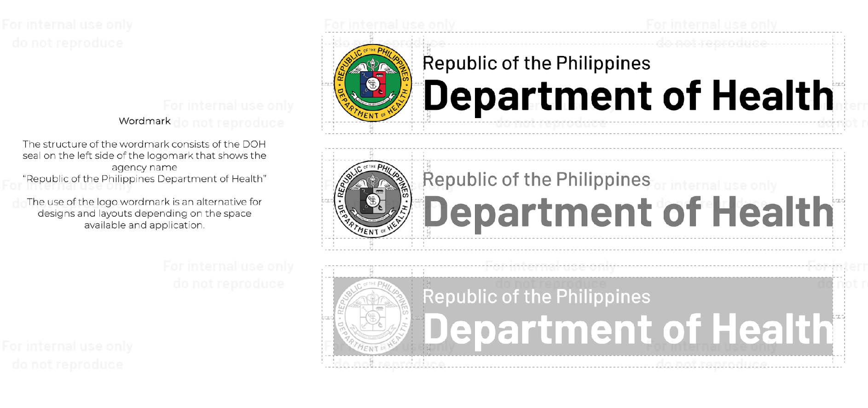
Notes:
Seal always on the left
Agency name larger
Use the correct color version depending on background
Follow proper spacing and alignment

Slide 7
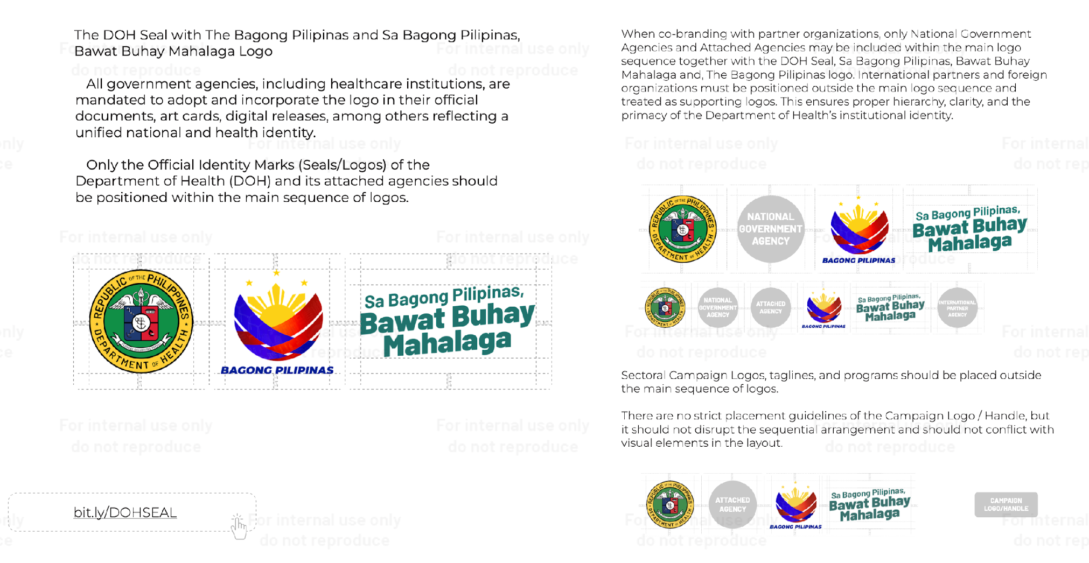

Slide 8
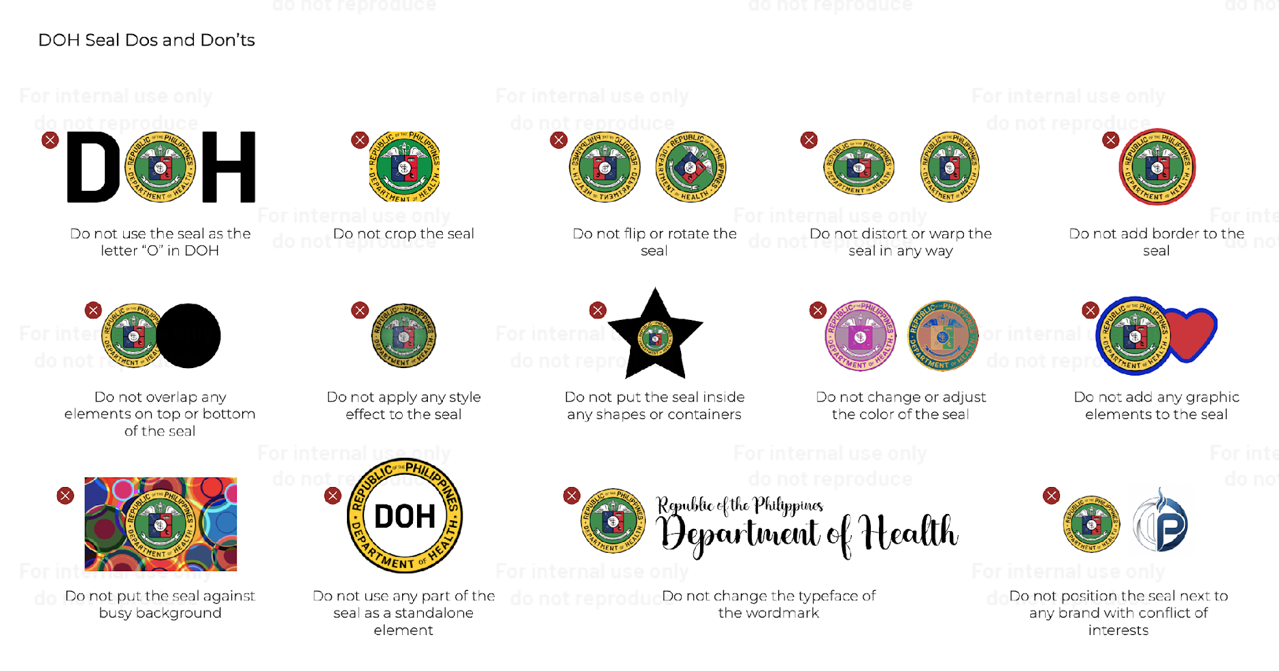

Slide 9
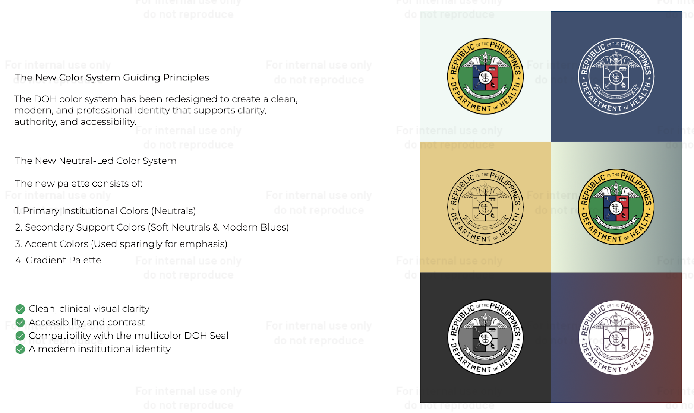

Slide 10
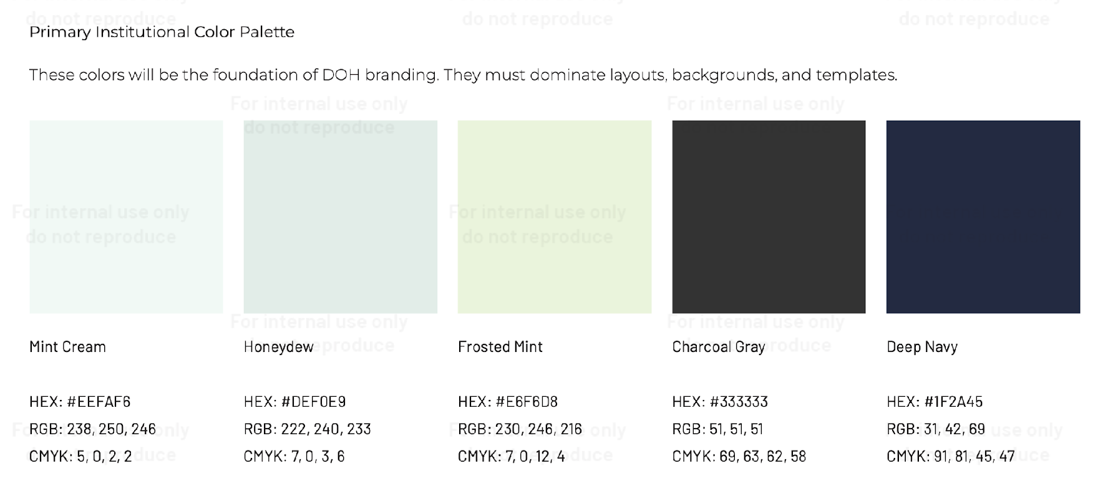

Slide 11
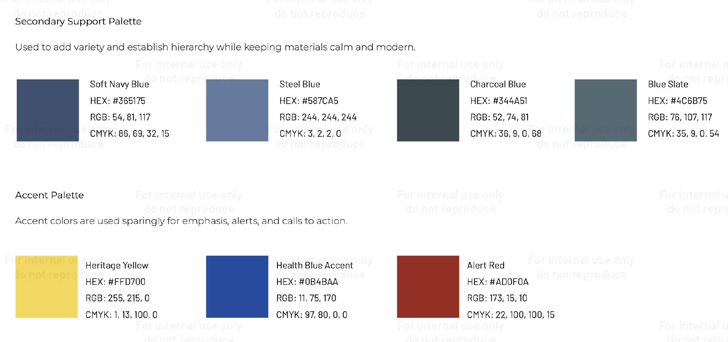

Slide 12
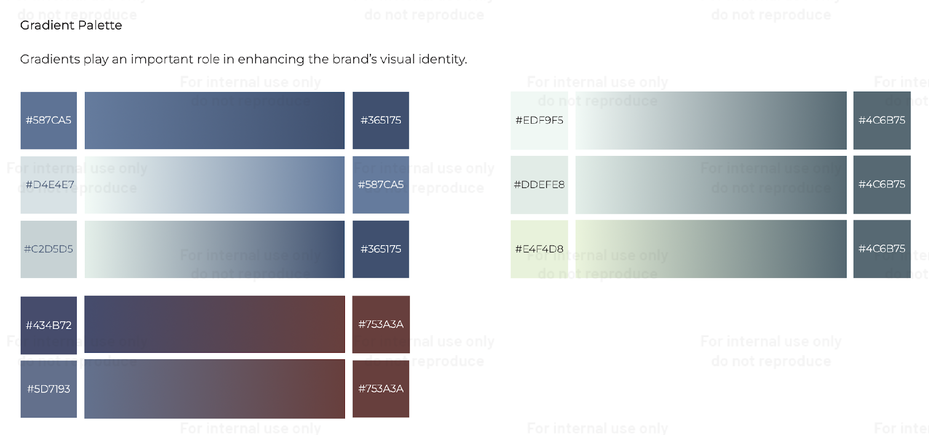

Slide 13
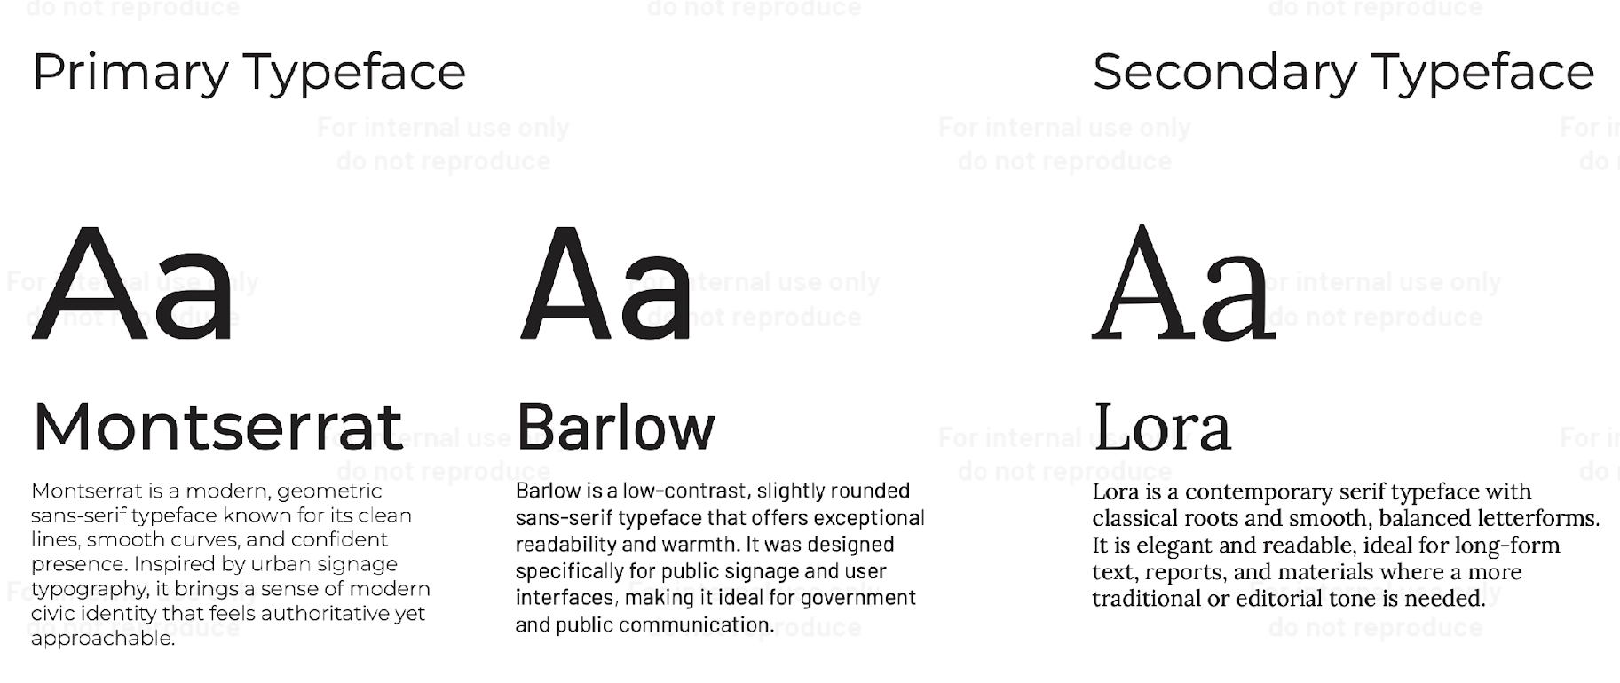

Slide 14
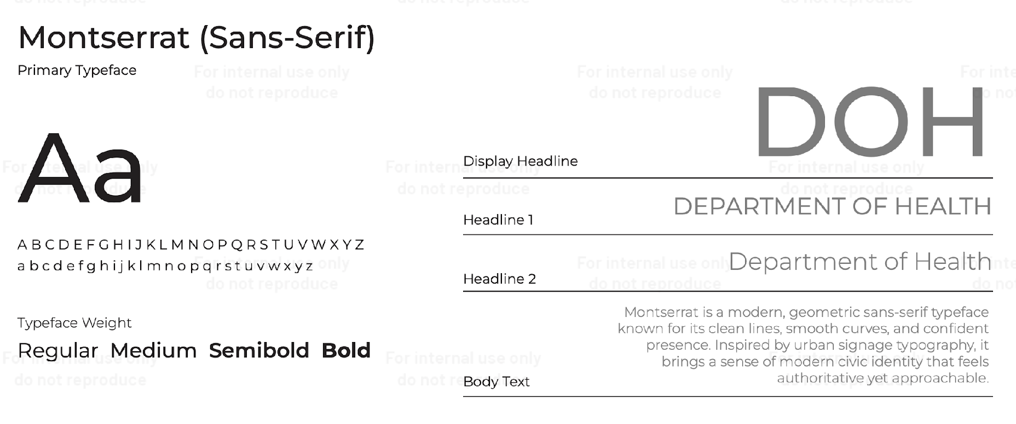
Notes:
This is used primarily with our presentations, social media graphics.

Slide 15
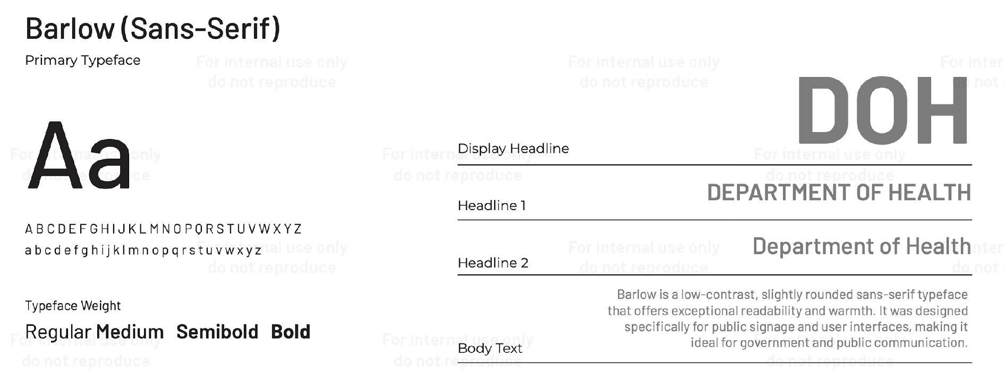

Slide 16
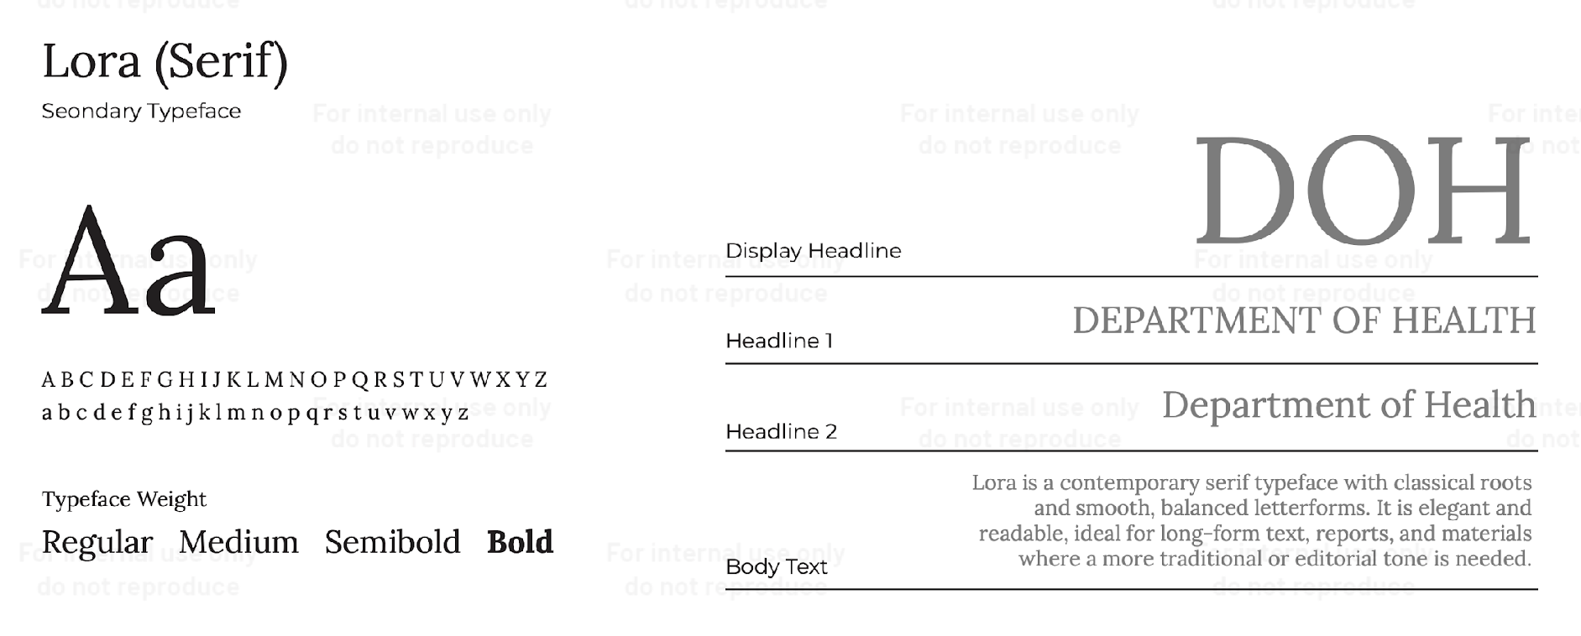

Slide 17
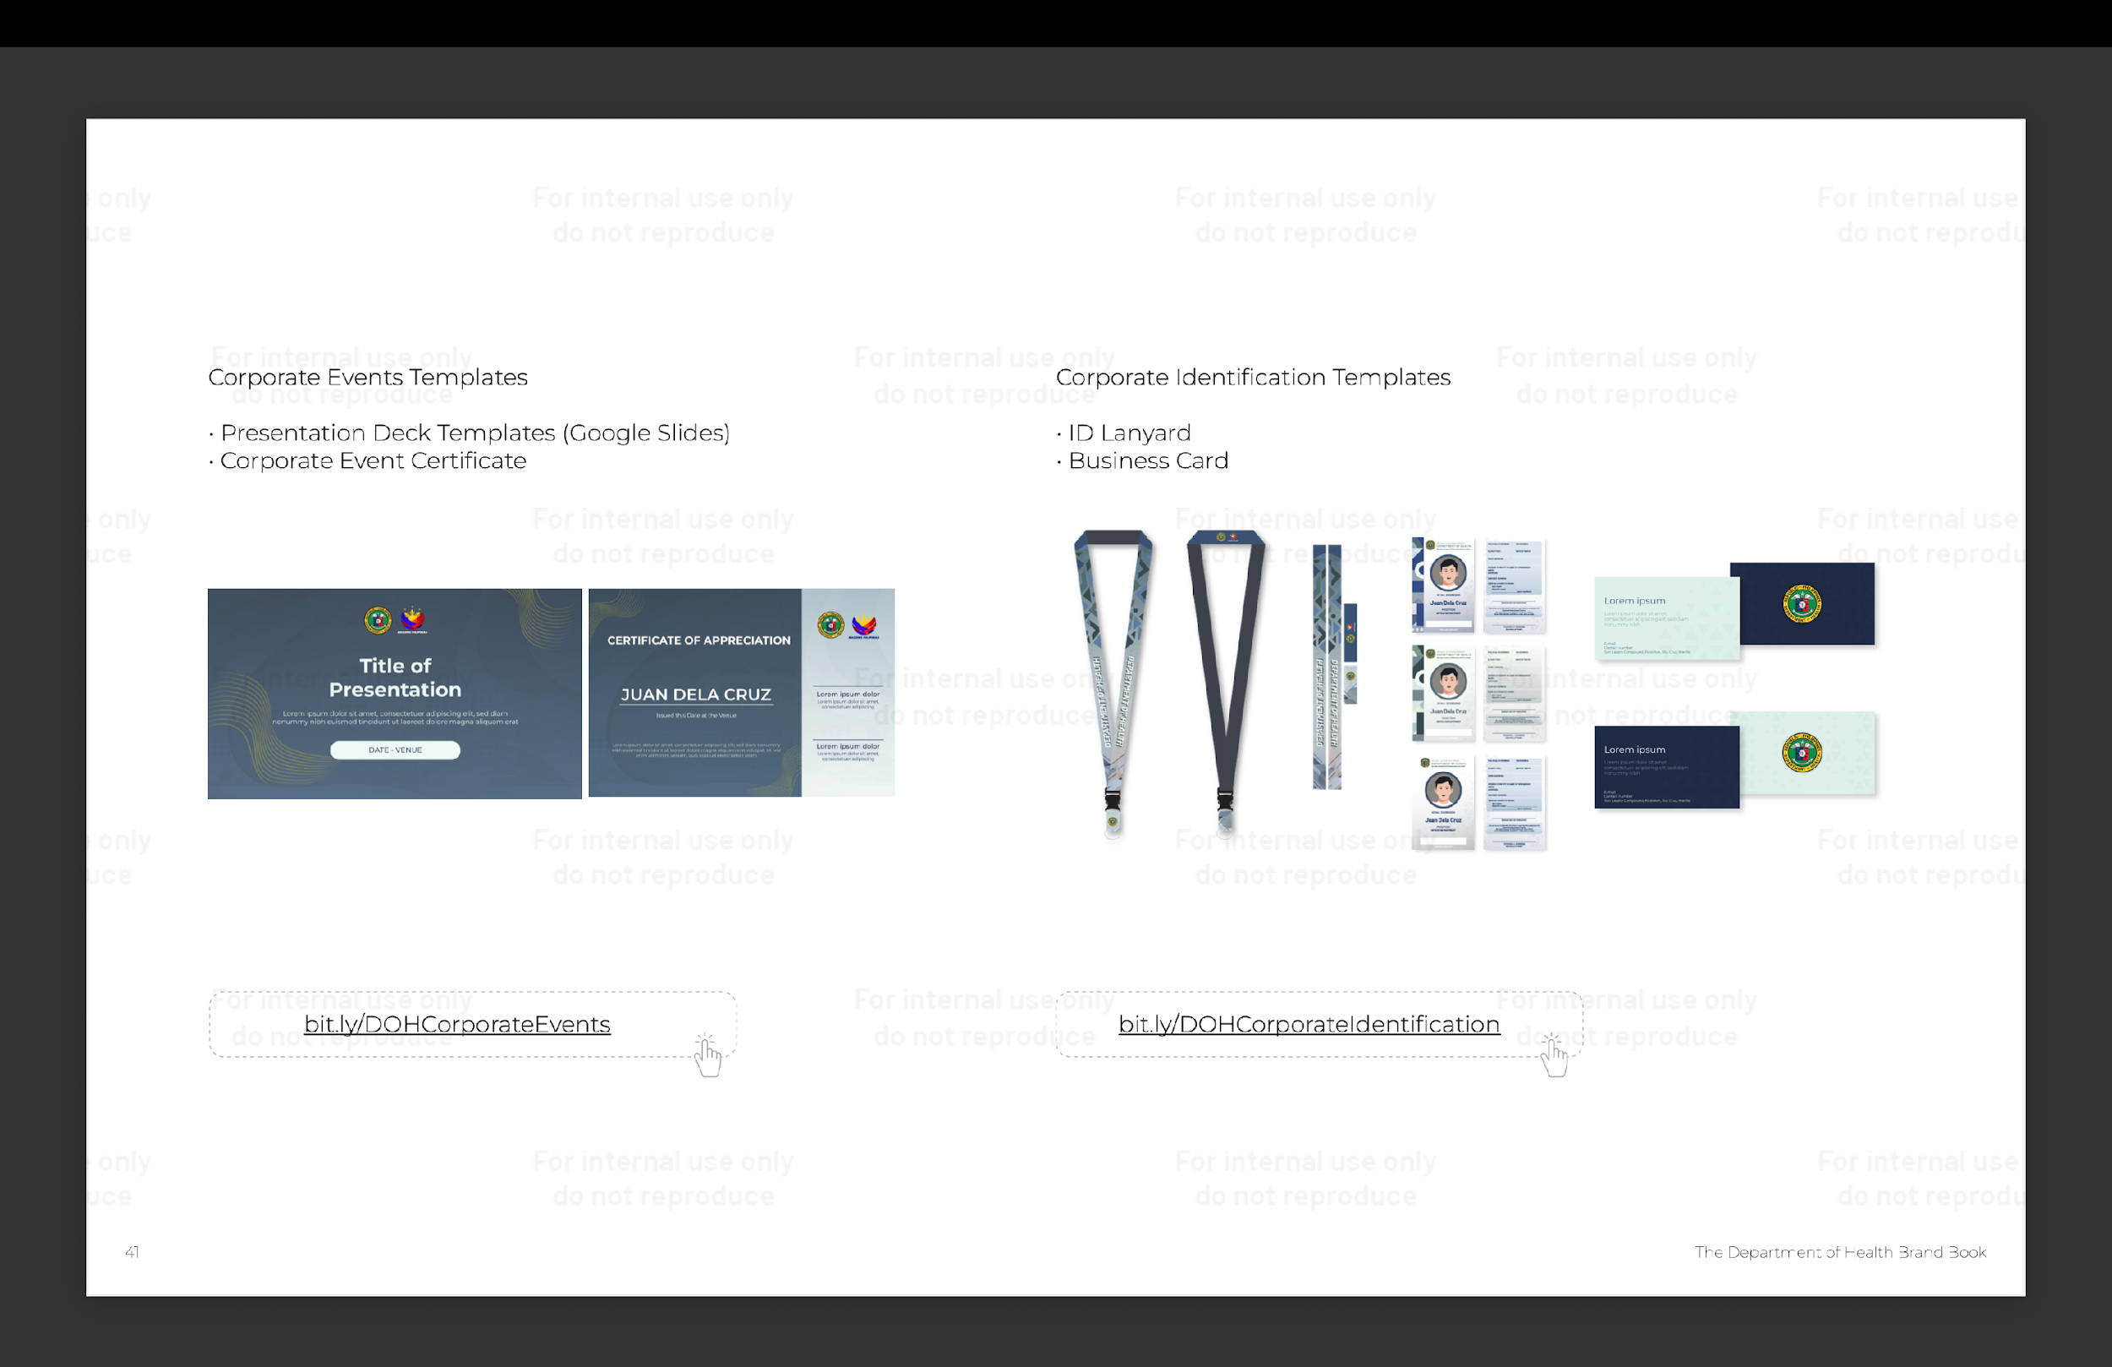
Notes:
For our deck templates and event certificates, the following updates have been made.
Same with our lanyards and IDs, the blue one is for the COS, the green one is for plantilla, and the gray to white gradient is for GIP.

Slide 18
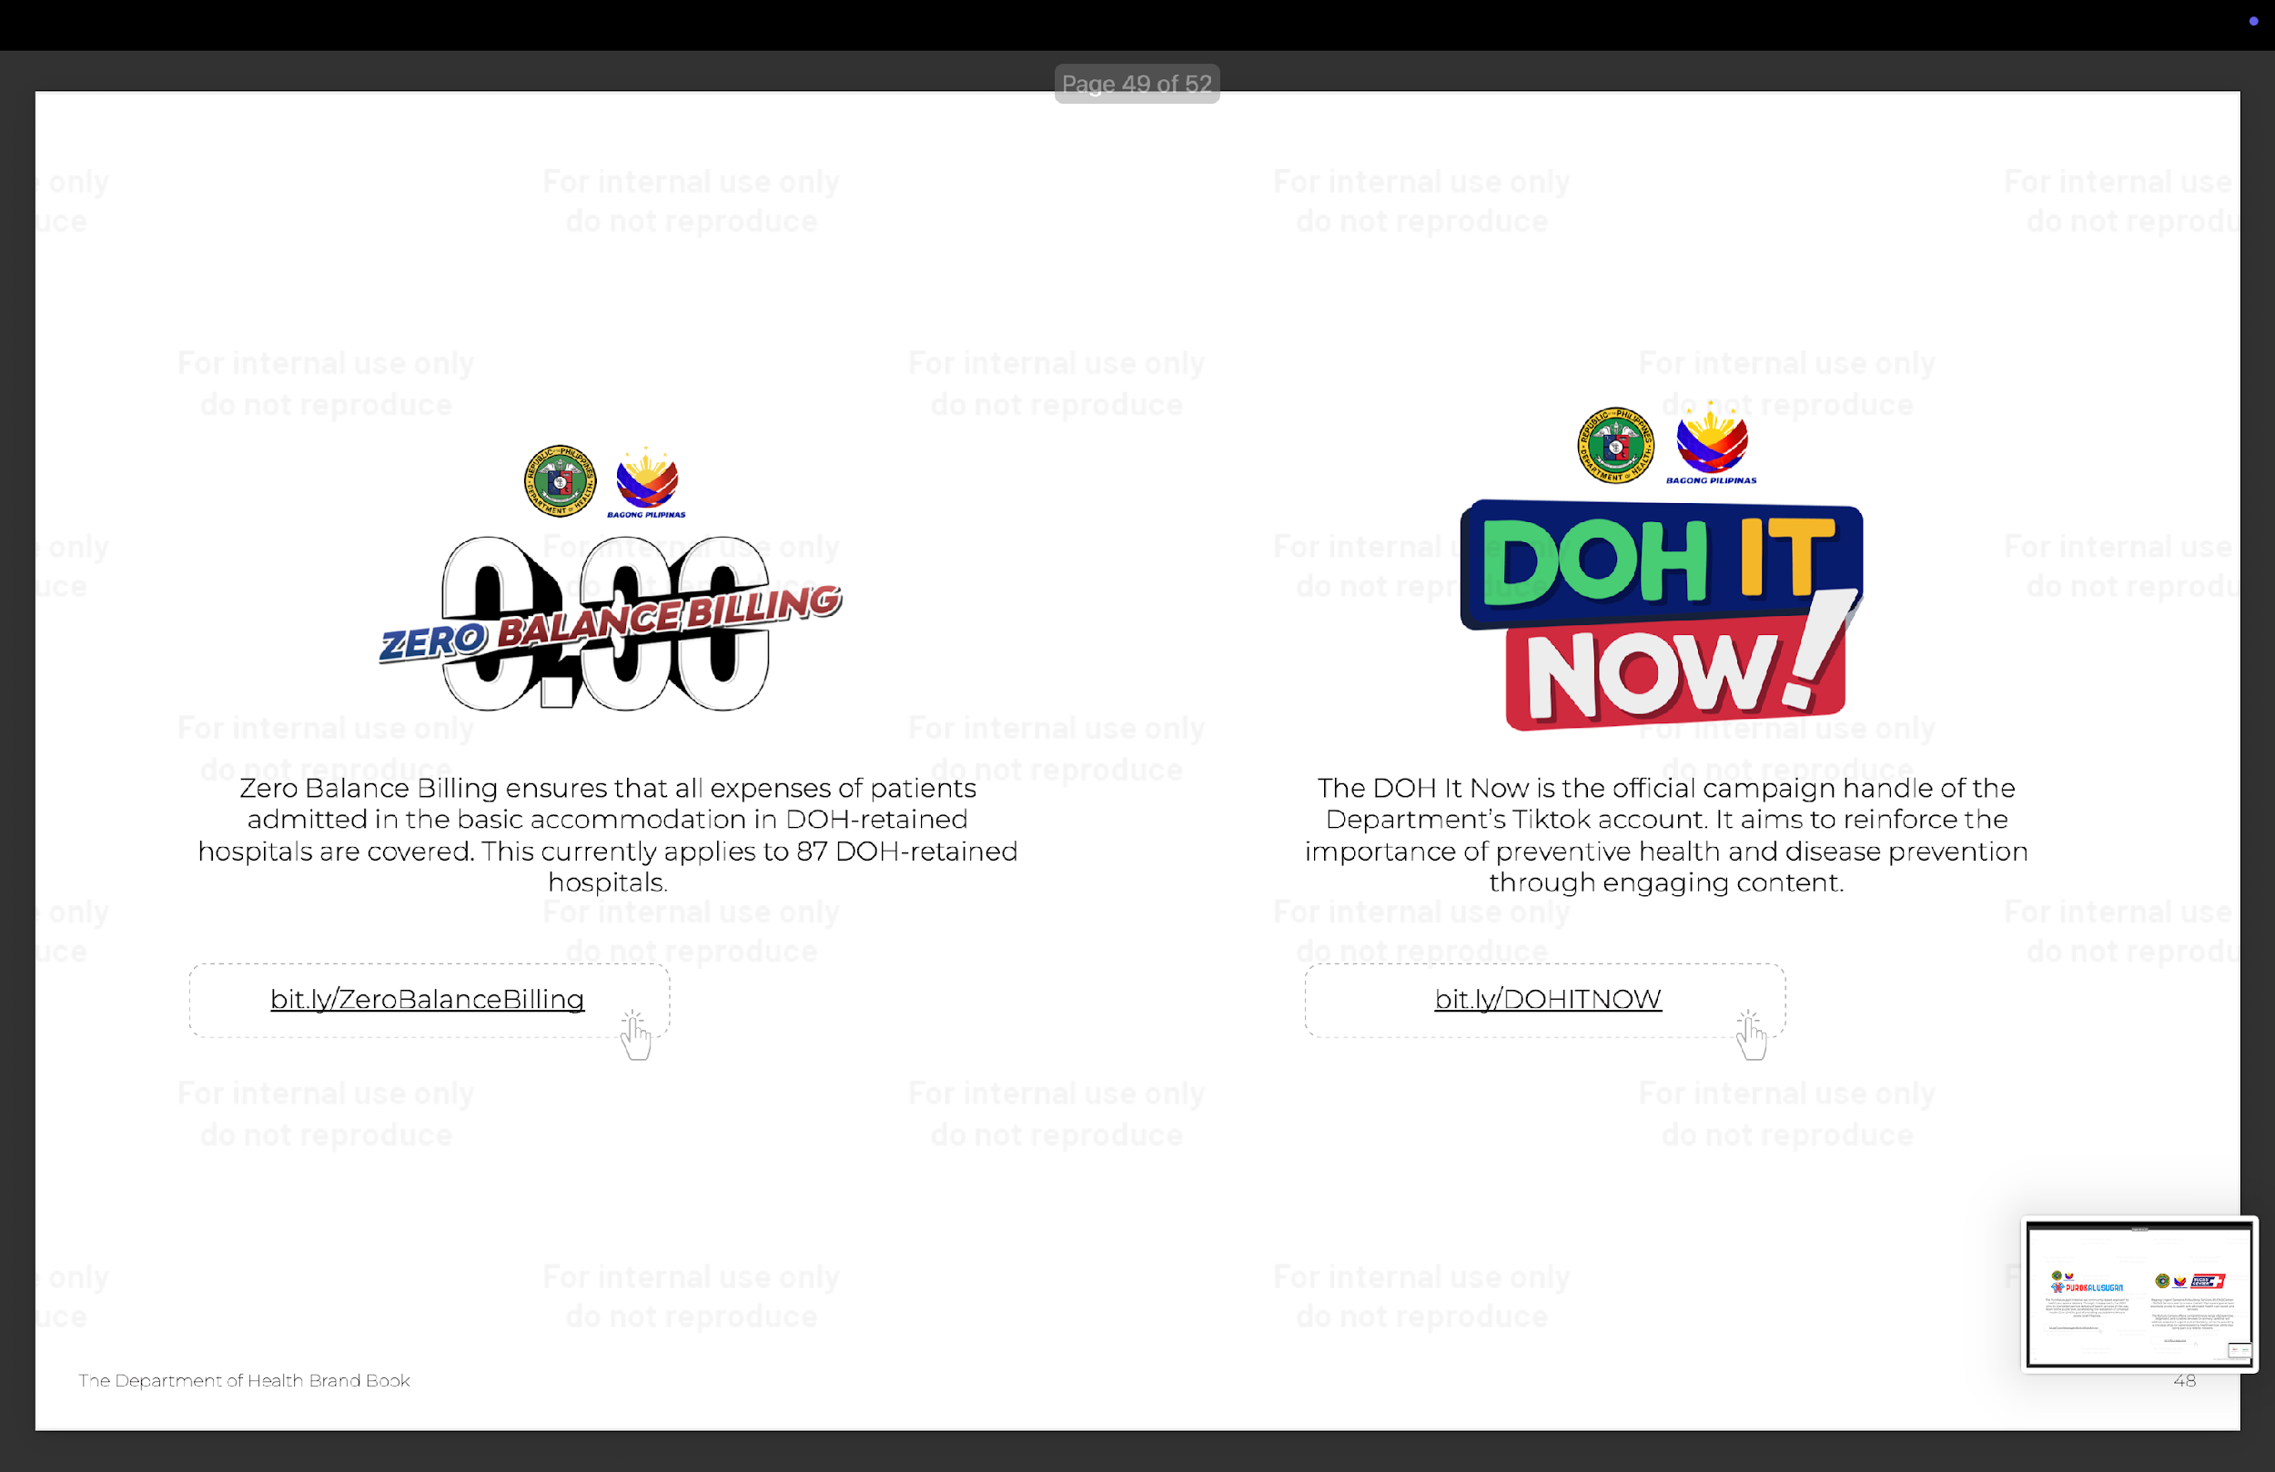
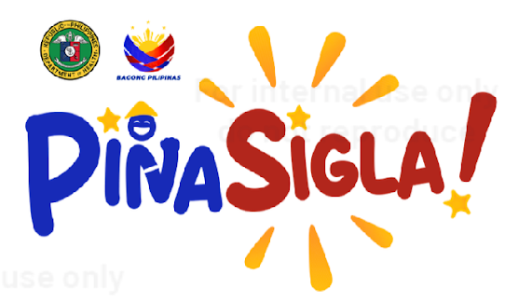
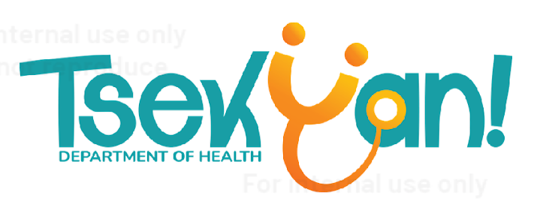
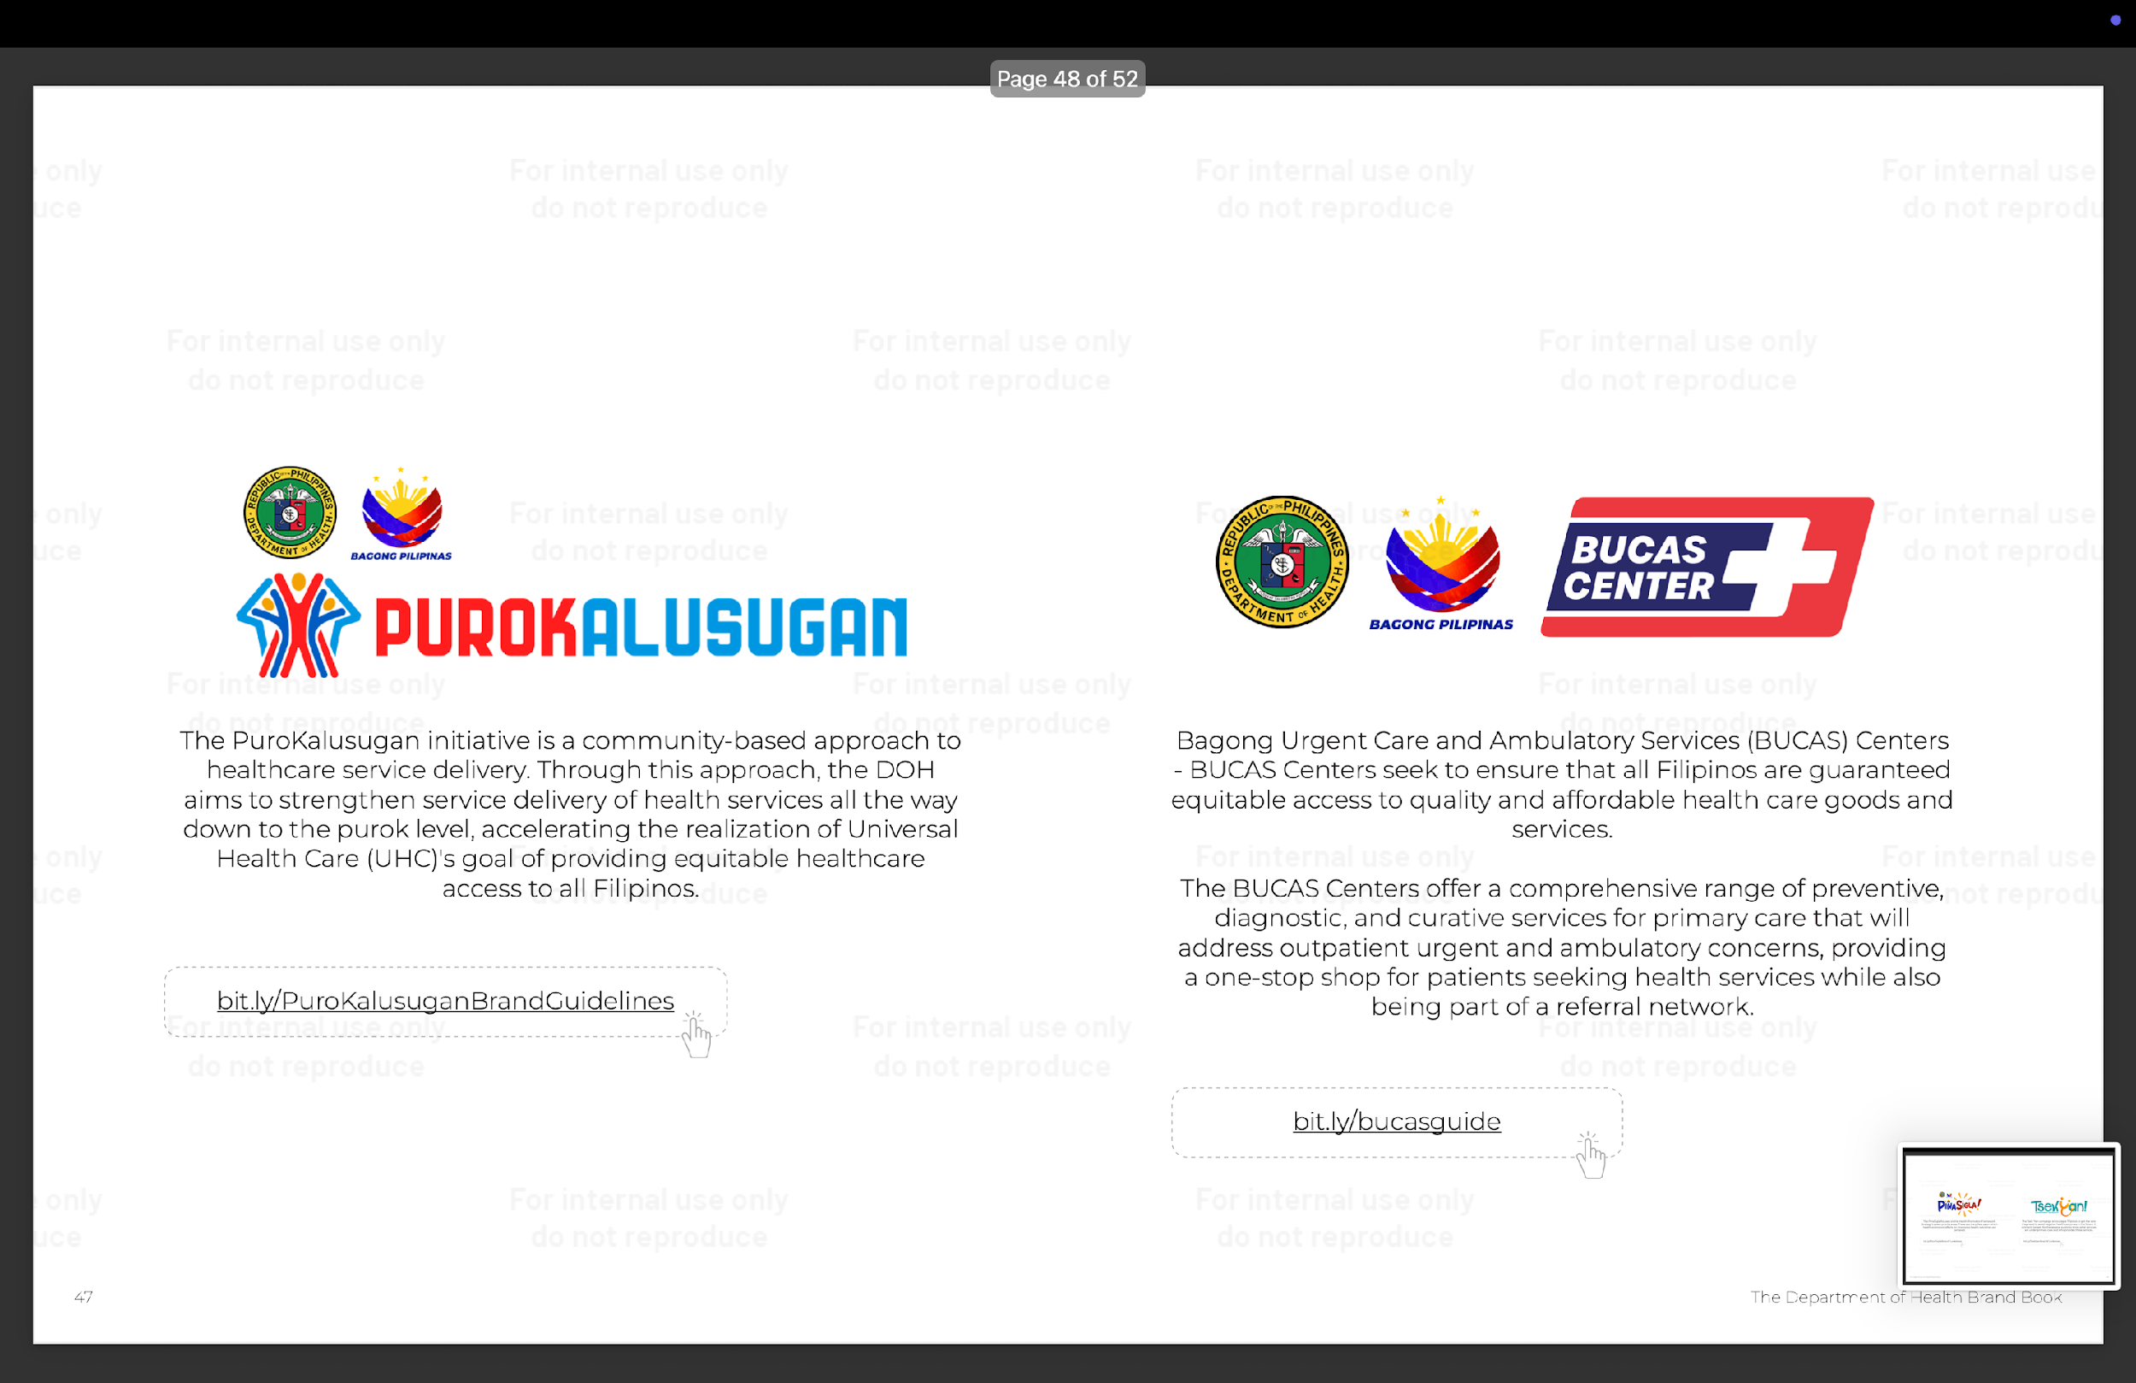
Notes:
These are our NATIONAL UNIFIED CAMPAIGNS. You will be seeing more of this with our postings.
The PinaSigla focuses on the Health Promotion Framework Strategy’s seven priority areas. These are the pillars upon which health promotion efforts for improving health outcomes are centered.
Zero Balance Billing ensures that all expenses of patients admitted in the basic accommodation in DOH-retained hospitals are covered. This currently applies to 87 DOH-retained hospitals.
The Tsek ‘Yan campaign encourages Filipinos to get the care they need to avoid negative health outcomes in the future. It primarily targets for the general public to know what services are under primary care and who provides these services.
The PuroKalusugan initiative is a community-based approach to healthcare service delivery. Through this approach, the DOH aims to strengthen service delivery of health services all the way down to the purok level, accelerating the realization of Universal Health Care (UHC)'s goal of providing equitable healthcare access to all Filipinos.
Bagong Urgent Care and Ambulatory Services (BUCAS) Centers - BUCAS Centers seek to ensure that all Filipinos are guaranteed equitable access to quality and affordable health care goods and services.
The BUCAS Centers offer a comprehensive range of preventive, diagnostic, and curative services for primary care that will address outpatient urgent and ambulatory concerns, providing a one-stop shop for patients seeking health services while also being part of a referral network.
The DOH It Now is the official campaign handle of the Department’s Tiktok account. It aims to reinforce the importance of preventive health and disease prevention through engaging content.

Slide 19

Maraming Salamat po!

